Slide 1
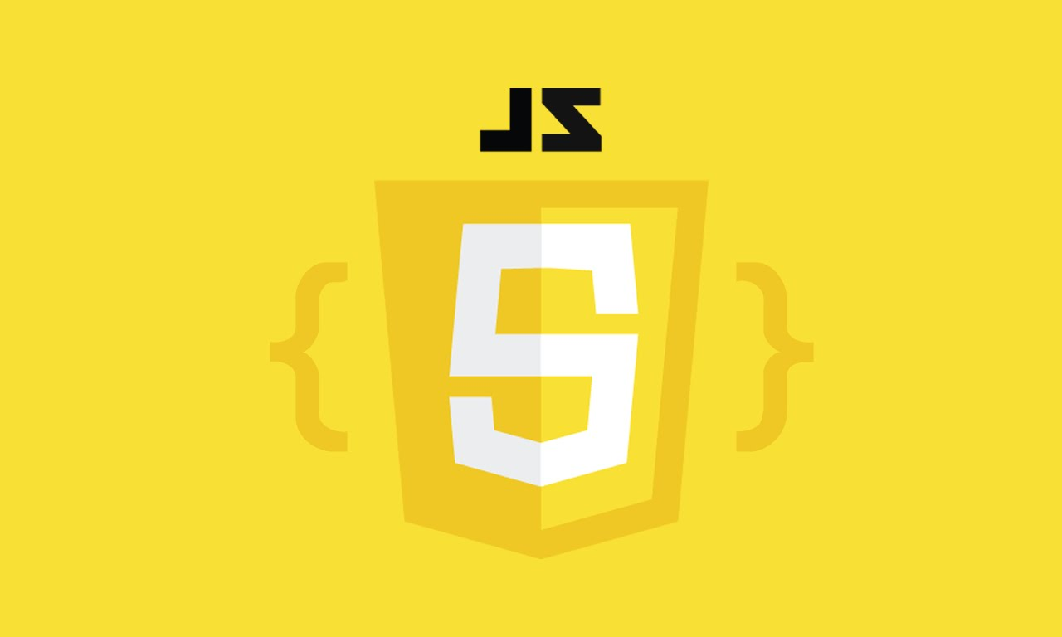
An Introduction to JavaScript

Slide 2
What is JavaScript
JavaScript is a cross-platform, object-oriented scripting language used to make webpages interactive (e.g. having complex animations, clickable buttons, popup menus, etc.). There are also more advanced server side versions of JavaScript such as Node.js which allow you to add more functionality to a website than simply downloading files (such as real-time collaboration between multiple computers).

Slide 3
Cont.…
JavaScript was initially created to “make web pages alive”.
The programs in this language are called scripts. They can be written right in a web page’s HTML and run automatically as the page loads.
Scripts are provided and executed as plain text. They don’t need special preparation or compilation to run.
In this aspect, JavaScript is very different from another language called Java.

Slide 4
Why JavaScript
When JavaScript was created, it initially had another name: “LiveScript”. But Java was very popular at that time, so it was decided that positioning a new language as a “younger brother” of Java would help.
But as it evolved, JavaScript became a fully independent language with its own specification called ECMAScript, European Computer Manufactures Association and now it has no relation to Java at all.

Slide 5
Cont.…
Today, JavaScript can execute not only in the browser, but also on the server, or actually on any device that has a special program called the JavaScript engine. Computer Program that executes JS Code. The browser has an embedded engine sometimes called a “JavaScript virtual machine”.
Different engines have different “codenames”. For example:
V8 – in Chrome and Opera.
SpiderMonkey – in Firefox.
There are other codenames like “Trident” and “Chakra” for different versions of IE, “ChakraCore” for Microsoft Edge, “Nitro” and “SquirrelFish” for Safari, etc.

Slide 6
What can in-browser JavaScript do
Modern JavaScript is a “safe” programming language. It does not provide low-level access to memory or CPU, because it was initially created for browsers which do not require it.
JavaScript’s capabilities greatly depend on the environment it’s running in. For instance, Node.js supports functions that allow JavaScript to read/write arbitrary files, perform network requests, etc.
In-browser JavaScript can do everything related to webpage manipulation, interaction with the user, and the webserver.

Slide 7
For instance, in-browser JavaScript is able to:
Add new HTML to the page, change the existing content, modify styles.
React to user actions, run on mouse clicks, pointer movements, key presses.
Send requests over the network to remote servers, download and upload files (so-called AJAX and COMET technologies).
Get and set cookies, ask questions to the visitor, show messages.
Remember the data on the client-side (“local storage”).
Notes:
Ajax (also AJAX /ˈeɪdʒæks/; short for asynchronous JavaScript and XML)^{[1][2]} is a set of web development techniques using many web technologies on the client side to create asynchronous web applications. With Ajax, web applications can send and retrieve data from a server asynchronously (in the background) without interfering with the display and behavior of the existing page.
Comet is a web application model in which a long-held HTTPS request allows a web server to push data to a browser, without the browser explicitly requesting it.

Slide 8
What Can‘t in-browser JavaScript do
JavaScript’s abilities in the browser are limited for the sake of the user’s safety. The aim is to prevent an evil webpage from accessing private information or harming the user’s data.
Examples of such restrictions include:
JavaScript on a webpage may not read/write arbitrary files on the hard disk, copy them or execute programs. It has no direct access to OS system functions.
There are ways to interact with camera/microphone and other devices, but they require a user’s explicit permission.
Notes:
Modern browsers allow it to work with files, but the access is limited and only provided if the user does certain actions, like “dropping” a file into a browser window or selecting it via an <input> tag.

Slide 9
What makes JavaScript unique
There are at least three great things about JavaScript:
Full integration, incorporation with HTML/CSS.
Simple things are done simply.
Support by all major browsers and enabled by default.
JavaScript is the only browser technology that combines these three things. That’s what makes JavaScript unique. That’s why it’s the most widespread tool for creating browser interfaces.
That said, JavaScript also allows to create servers, mobile applications, etc.

Slide 10
Code editors
A code editor is the place where programmers spend most of their time.
There are two main types of code editors: IDEs and lightweight editors. Many people use one tool of each type.
If you haven’t selected an IDE yet, consider the following options:
Visual Studio Code (cross-platform, free).
WebStorm (cross-platform, paid).
Notes:
The term IDE (Integrated Development Environment) refers to a powerful editor with many features that usually operates on a “whole project.” As the name suggests, it’s not just an editor, but a full-scale “development environment.”
An IDE loads the project (which can be many files), allows navigation between files, provides autocompletion based on the whole project (not just the open file), and integrates with a version management system (like git), a testing environment, and other “project-level” stuff.
“Lightweight editors” are not as powerful as IDEs, but they’re fast, elegant and simple.
They are mainly used to open and edit a file instantly.
The main difference between a “lightweight editor” and an “IDE” is that an IDE works on a project-level, so it loads much more data on start, analyzes the project structure if needed and so on. A lightweight editor is much faster if we need only one file.
In practice, lightweight editors may have a lot of plugins including directory-level syntax analyzers and autocompleters, so there’s no strict border between a lightweight editor and an IDE.
The following options deserve your attention:
Atom (cross-platform, free).
Sublime Text (cross-platform, shareware).
Notepad++ (Windows, free).
Vim and Emacs are also cool if you know how to use them.

Slide 11
Developer console
Code is prone to errors. You will quite likely make errors… Oh, what am I talking about? You are absolutely going to make errors, at least if you’re a human, not a robot.
But in the browser, users don’t see errors by default. So, if something goes wrong in the script, we won’t see what’s broken and can’t fix it.
To see errors and get a lot of other useful information about scripts, “developer tools” have been embedded in browsers.
Notes:
Most developers lean towards Chrome or Firefox for development because those browsers have the best developer tools. Other browsers also provide developer tools, sometimes with special features, but are usually playing “catch-up” to Chrome or Firefox. So most developers have a “favorite” browser and switch to others if a problem is browser-specific.
Developer tools are potent; they have many features. To start, we’ll learn how to open them, look at errors, and run JavaScript commands.

Slide 12
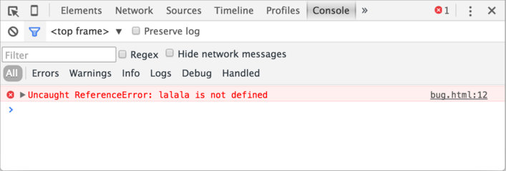
Google Chrome
Press F12 or, if you’re on Mac, then Cmd+Opt+J
The developer tools will open on the Console tab by default.
Notes:
Explain More about console …

Slide 13
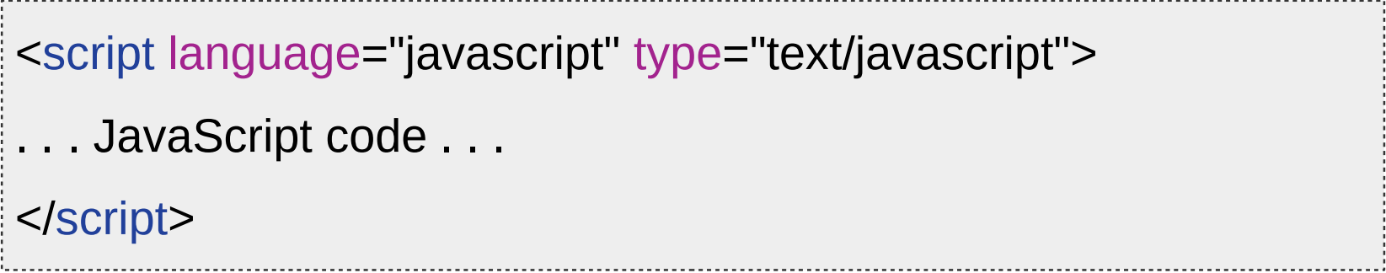
JS - first program
JavaScript can be implemented using JavaScript statements that are placed within the
<script>... </script> HTML tags in a web page

Slide 14
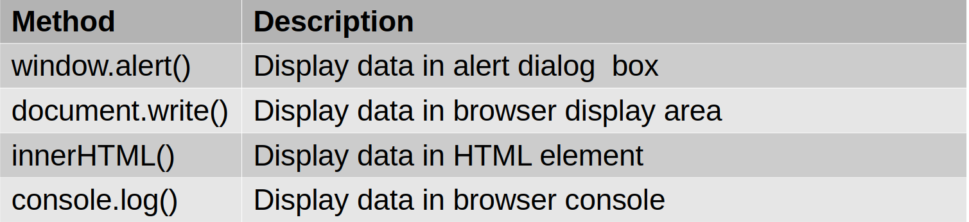
JavaScript - Output

Slide 15

JS – First Program

Slide 16
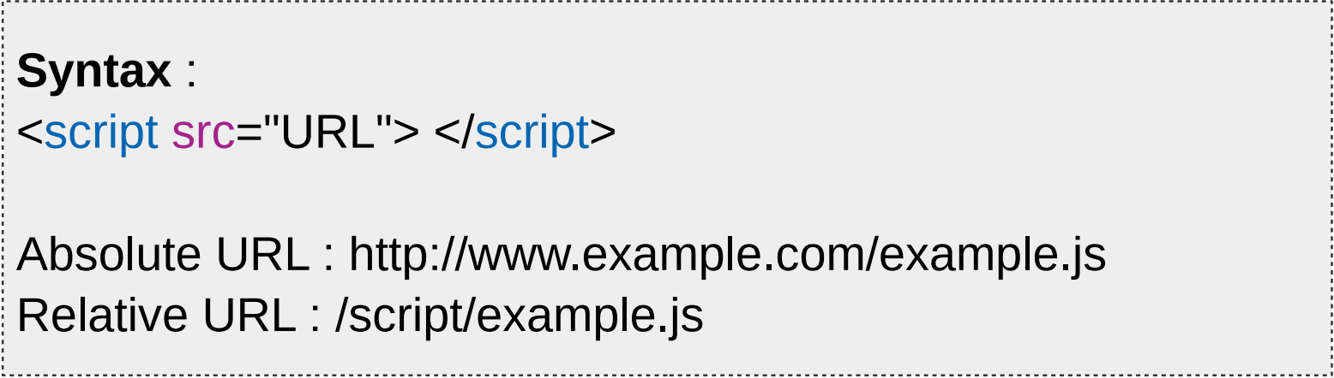
JS - External
External (or linked script) JavaScript can be inserted using src attribute

Slide 17
JS – Linked Script
Benefits :
Decoupling logic from presentation Re-use across pages
Disadvantage Script may load slowly Linking to remote script may pose security threat

Slide 18
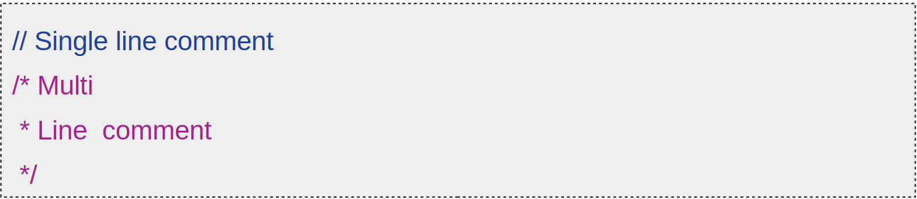
Comments

Slide 19
End

